Slide 1
Topics in AI:
Convolution Neural Network
by
Prof. Mashhour Solh
MileStone 2.5
Pedestrian Detection
Group B :
Vidish Naik
Charulata Lodha
Rakesh Nagaraju
Joel Alvares

Slide 2
Contents
Idea of the Project - Vidish
Repulsion Loss Explanation - Vidish
Tech Spec, Flowchart - Vidish
Annotations - Charu
Crisp Explanation of Flow :
Training (SSD) - Charu ,
Testing (no MAP) - Rakesh
PR Curve - Rakesh
Demo : - Joel
Colab Setup
SSD Model Test Image of us - Run with Occlusion
Faster RCNN : Test Image Run

Slide 3
Idea of the Project
The approaches that we reviewed for last milestone:
Center and Scale Prediction
Objects as Points
Repulsion Loss
Part-Level CNN for Pedestrian Detection Using Saliency and Boundary Box Alignment
We chose to move forward with Repulsion Loss as our project.
We found that Faster RCNN has a better accuracy and we want to try to see the effects of repulsion loss as its loss function.
Our aim is to improve the accuracy of pedestrian detection using Faster RCNN and repulsion loss.

Slide 4
Recap: Repulsion Loss
The idea of repulsion comes from the attraction and repulsion properties of magnets.
The predicted bounding boxes and ground truth act as magnets attracting each other.
All of the predicted boxes together act as magnets that are trying to repel each other.
Repulsion Loss is given by the formula
L = L_{Attr} + α∗L_{RepGT} + β ∗L_{RepBox}
L_{Attr} is the attraction term.
L_{RepGT} and L_{RepBox} are the repulsion terms.

Slide 5
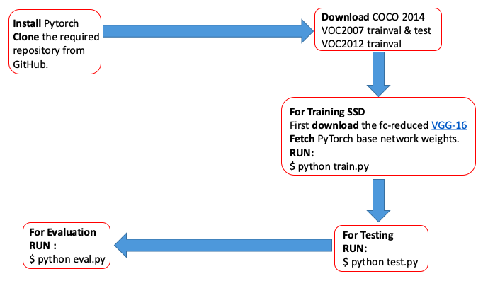
Flow of Execution

Slide 6
Tech Specs :
Technical Specs :
GPU : Tesla K80
PyTorch : 0.3.1
Torch Vision : 0.2.0
Data Set :
VOC 2007
VOC 2012
Weights:
fc-reduced VGG-16 PyTorch base network weights.
Pre-trained SSD network for detection :
SSD300 trained on VOC0712 (newest PyTorch weights)
Total classes : 21
Person, Bird, Bicycle, Horse, etc.

Slide 7
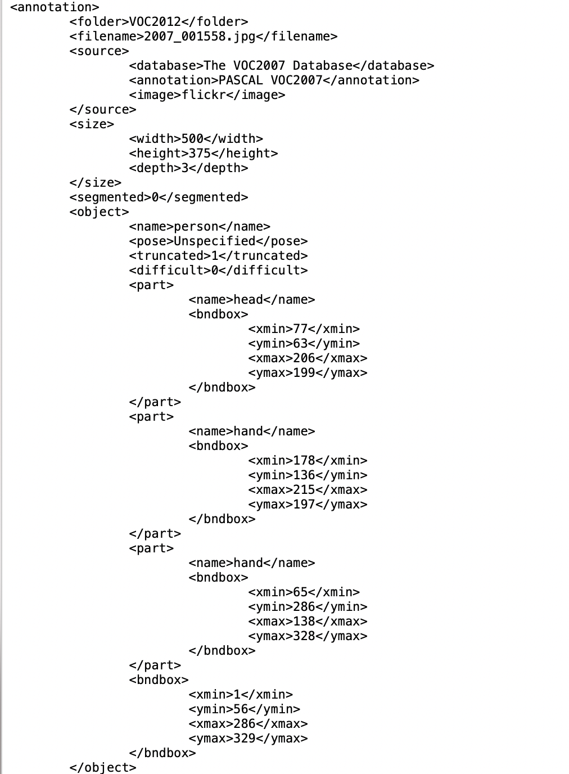
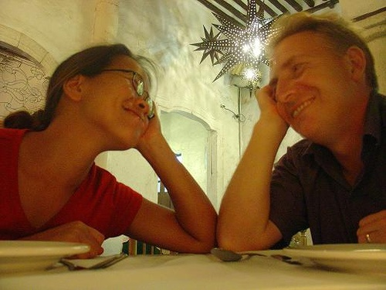
XML Annotations

Slide 8
Training
The model currently supports only VOC and COCO dataset.
Train VOC dataset: 9,963 images containing 24,640 annotated objects.
To train SSD using the train script simply specify the parameters listed in train.py as a flag or manually change them.
Before starting the training phase, parameters like batch size, weight decay, momentum, gamma and learning rate are set otherwise default values are used.
ssd_net = build_ssd('train', cfg['min_dim'], cfg['num_classes'])
ssd_net.vgg.load_state_dict(vgg_weights)
optimizer = optim.SGD(net.parameters(), lr=args.lr, momentum=args.momentum, weight_decay=args.weight_decay)
criterion = MultiBoxLoss(cfg['num_classes'], 0.5, True, 0, True, 3, 0.5, False, args.cuda)
Data loader
Batch Iterator :
adjust_learning_rate
load batch of train images
forward
loss_l, loss_l_repul, loss_c = criterion(out, targets)
loss.backward()
optimizer.step()

Slide 9
Utility Files
prior.py:
It computes the coordinates of the prior box in the form of center-offset for each source feature map by calculating and summing different means and returns an output with x, y coordinates for the top left and bottom right corner of the prior box.
detection.py:
This is the final layer of SSD and is called during testing. It decodes location predictions and applies non-maximum suppression(NMS) based on threshold to a top k number of output predictions for both confidence scores and locations.
repulsion_loss.py:
It calculates the repulsion loss as the sum over IoG values using location data, ground truth data, and prior data.

Slide 10
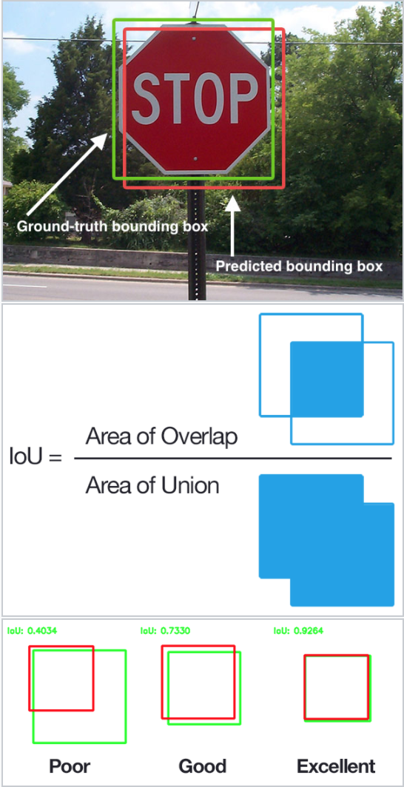
IoU aka
jaccard index

Slide 11
SSD
Single Shot Multibox Detector architecture is composed of a base VGG network followed by the added multi-box convolution layer.
While creating the SSD network, it computes prior-box coordinates in the center-offset form for each source feature map.
Stochastic Gradient Descent (SGD) is adopted to optimize the network with the weight decay parameter as 5e-4, momentum as 0.9, and learning-rate as 1e-3.

Slide 12
Training Continued...
The data loader then combines a dataset, and provides an iterable over the given dataset.
In each batch iteration, the initial learning rate is decayed at specific step intervals.
A forward pass computes the loss followed by backpropagation to update the weights on the batch of images.
The multi-box loss function calculates Confidence Target Indices, by matching ground truth boxes with Prior boxes, which have jaccard index greater than the threshold parameter (default threshold = 0.5).

Slide 13
Training Continued...
Hard negative mining is done to filter out the excessive number of negative examples associated with a large number of default bounding boxes. (default negative: positive ratio 3:1).
This program returns three-loss values:
Localization loss (how far away the network’s predicted bounding boxes are from the ground truth),
Repulsion loss (sum over IoU), and
Confidence loss (how confident the network is).
Final loss is a sum of Localization loss, Repulsion loss, and Confidence loss, each of which are returned by the multi-box loss function.

Slide 14
Evaluation:
After completing the training, the next step is to evaluate the model’s performance using the test dataset.
“test.py” is run on the test dataset and predictions(x1,y1,x2,y2) are generated during forward pass and results are stored in a text file.
The evaluation file “eval.py” generates bounding boxes over its predictions.
Overlap of predicted bounding boxes and ground truth boxes is then calculated using the maximum of the x, y coordinates of the top left corner and minimum of x, y coordinates of bottom right corner of either ground truth box or predicted box, giving us the intersection area.

Slide 15
Evaluation:
The area for union is calculated to get a value which should be greater than threshold value, 0.5 in this case, to qualify as a successful prediction.
Depending on the prediction, we classify it in true positive(TP) or false positive(FP) and we calculate precision and recall as shown in the next section.

Slide 16
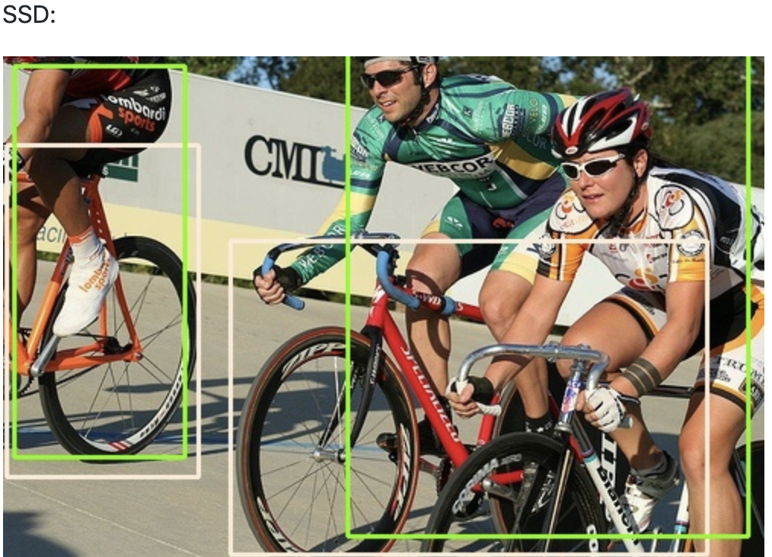
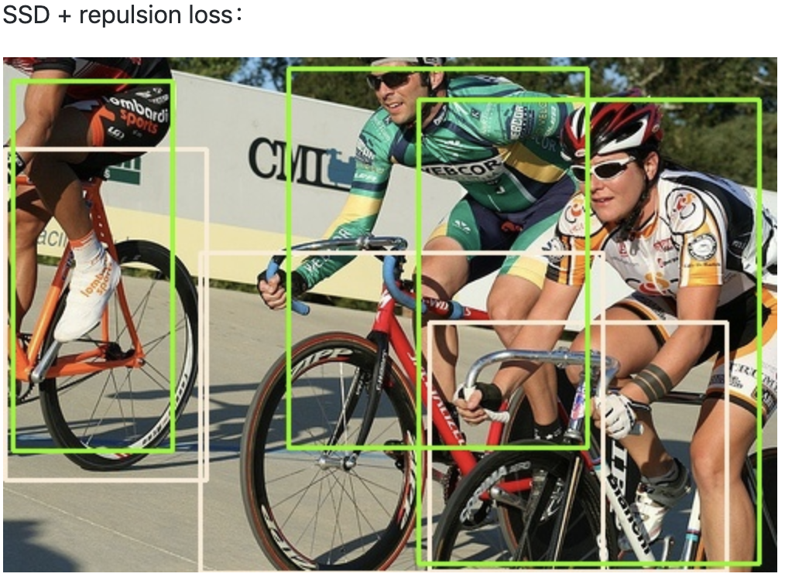

Slide 17
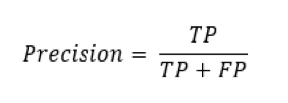
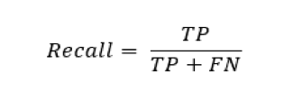
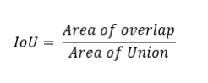
PR Curve:
The metrics required to calculate precision and recall such as True Positives, False Positives and False Negatives are calculated using Intersection over Union (IoU) which is given by: Area of Overlap/Area of Union.
Precision measures the ratio of true positives over all positive predictions which includes false positives.
Recall is the ratio of the number of positives predicted accurately.

Slide 18
PR Curve:
The metrics used to calculate precision and accuracy are as follows:
A True positive would have the correct classification with an IoU > 0.5.
A False positive could be possible in two cases, where either would have the correct classification with an IoU < 0.5 or a duplicate bounding box for an object already classified.
A False negative prediction would have an IoU > 0.5, but the wrong classification.
In Figure we have calculated the precision and recall for the classes above to generate the PR curve.

Slide 19
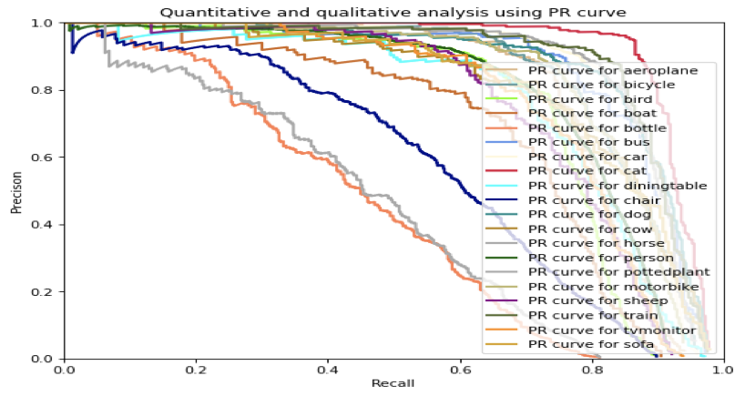
High scores for low false positive rate and low false negative rate show that the classifier is returning accurate results (high precision), as well as returning a majority of all positive results (high recall).

Slide 20
Demo
Colab Setup
SSD Model Test Images with Occlusion
Faster RCNN : Test Image with Occlusion

Slide 21
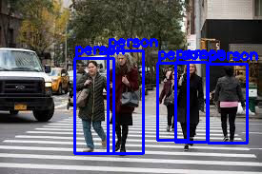
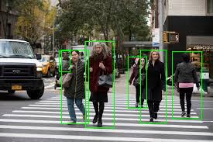
Results - 1

Slide 22
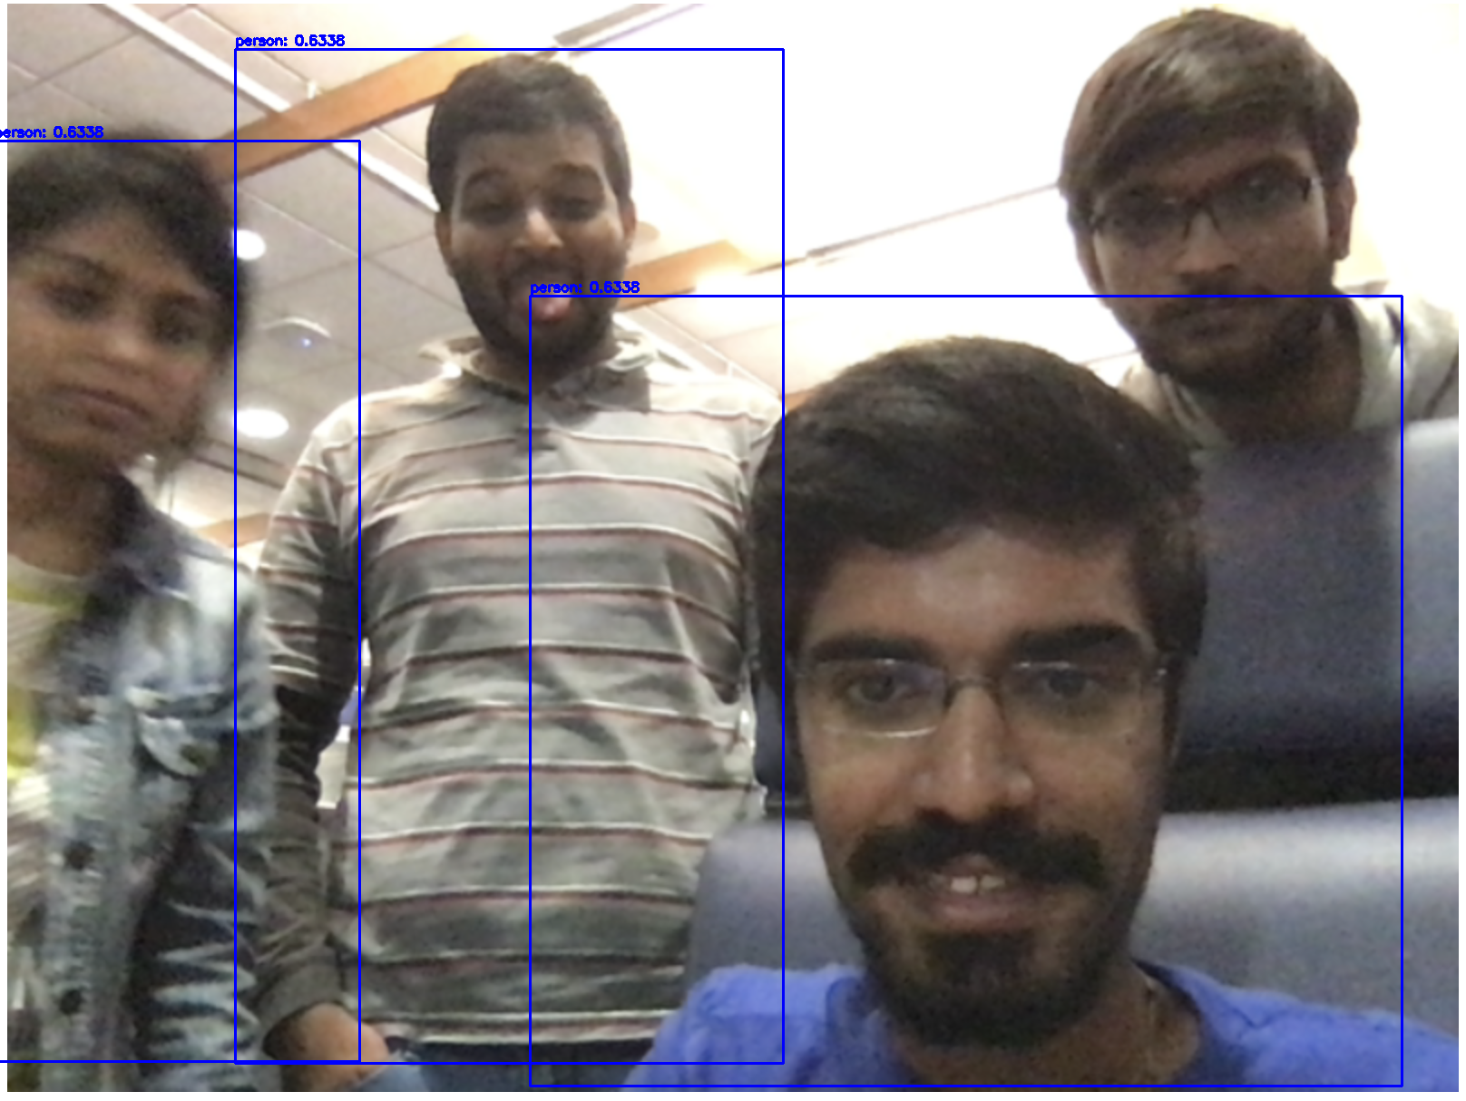

Results - 2

Slide 23
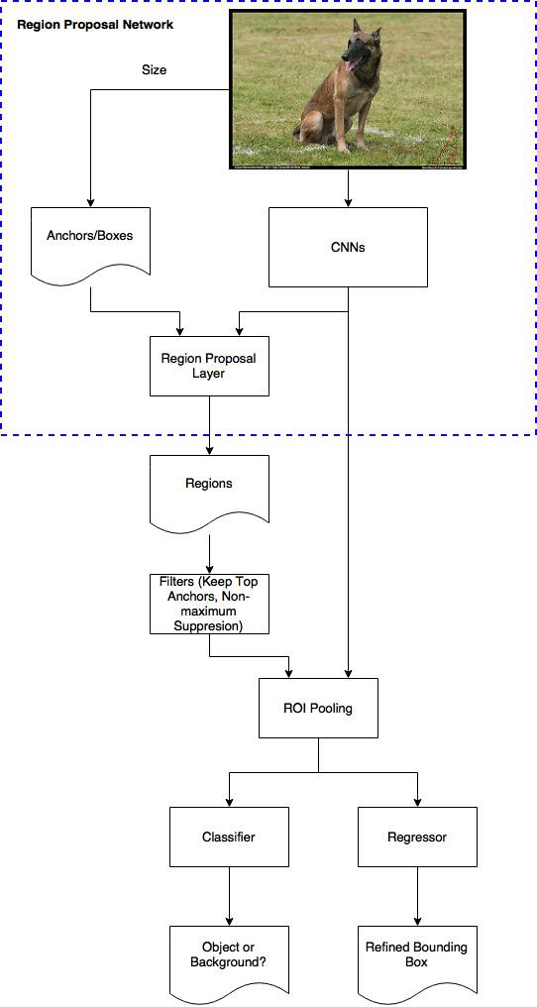
Faster R-CNN
Faster R-CNN is a sliding window-based approach
It has a dedicated region proposal network followed by max-pooling and a classifier to classify the object in the proposed region.

Slide 24
Future Work
SSD with repulsion loss is facing issues while detecting objects that are too close even after applying repulsion loss and at times fails to detect objects that are too small.
As the next steps, we plan on using Faster R-CNN as the object detector with repulsion loss and compare the accuracy with that of the SSD based network.
Other than this we also plan on utilizing other regression-based loss functions such as soft margin loss and hinge embedding loss, different types of optimizers to update the weights such as Adagrad, AdaDelta, RMSProp, NAG, Adam and various types of decaying learning rates such as time-based decay and step decay.

Slide 25
References
Repulsion Loss: Detecting Pedestrians in a Crowd : https://arxiv.org/pdf/1711.07752v2.pdf
https://github.com/bailvwangzi/repulsion_loss_ssd
Faster R-CNN (link: https://arxiv.org/abs/1506.01497)
https://towardsdatascience.com/learning-rate-schedules-and-adaptive-learning-rate-methods-for-deep-learning-2c8f433990d1
https://medium.com/datadriveninvestor/overview-of-different-optimizers-for-neural-networks-e0ed119440c3
https://medium.com/@jonathan_hui/what-do-we-learn-from-single-shot-object-detectors-ssd-yolo-fpn-focal-loss-3888677c5f4d
https://medium.com/@jonathan_hui/object-detection-speed-and-accuracy-comparison-faster-r-cnn-r-fcn-ssd-and-yolo-5425656ae359
https://towardsdatascience.com/breaking-down-mean-average-precision-map-ae462f623a52
https://medium.com/@smallfishbigsea/faster-r-cnn-explained-864d4fb7e3f8

